Slide 1

KS3 Mathematics
N6 Adding and subtracting fractions
Notes:
The aim of this unit is to teach pupils to:
Calculate fractions of quantities; add, subtract, multiply and divide fractions.
Material in this unit is linked to the Key Stage 3 Framework supplement of examples pp 66-69.

Slide 2
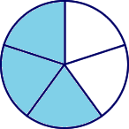
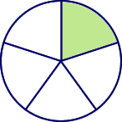
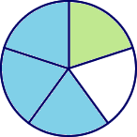


Adding and subtracting simple fractions
When fractions have the same denominator it is quite easy to add them together and to subtract them.
For example,
3
1
3 + 1
4
+
=
=
5
5
5
5
We can show this calculation in a diagram:
+
=
Notes:
Talk about adding fractions with the same denominator.
What is three fifths plus one fifth?
What are we adding? (fifths)
Three fifths plus one fifth is four fifths.
Show the example on the slide and emphasise that when the denominator is the same we can add together the numerators. Show that by writing (3 + 1) over 5 using a single bar we can avoid adding the denominators together by mistake.
Show the calculation as a diagram.

Slide 3
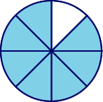
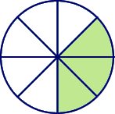
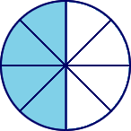
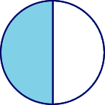
Adding and subtracting simple fractions
7
3
7 – 3
4
1
1
–
=
=
=
8
8
8
8
2
2
Fractions should always be cancelled down to their lowest terms.
We can show this calculation in a diagram:
–
=
Notes:
Talk through the example on the board and remind pupils that fractions should always be cancelled down to their lowest terms.
The 4 and the 8 in ⁴/₈ are both divisible by 4. Cancelling gives us ¹/₂.

Slide 4
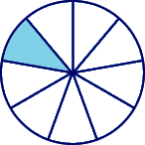
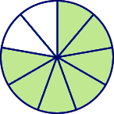
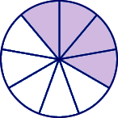
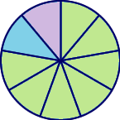
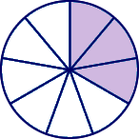
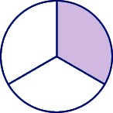
Adding and subtracting simple fractions
1
7
4
1 + 7 + 4
12
1
3
1
1
1
+
+
=
=
=
=
9
9
9
9
9
9
3
3
Top-heavy or improper fractions should be written as mixed numbers.
Again, we can show this calculation in a diagram:
+
+
=
Notes:
Improper fractions (top-heavy fractions) should be written as mixed numbers.
In the fraction ¹²/₉, 12 is bigger than 9. This is an improper (or top-heavy) fraction. ⁹/₉ make one whole plus ³/₉ left over.
Again, remind pupils that fractions must be cancelled if possible.
3 and 9 are both divisible by 3. Cancelling gives us ¹/₃.

Slide 5
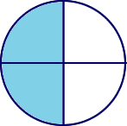
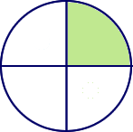
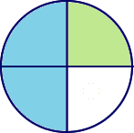
Adding and subtracting simple fractions
1
1
What is + ?
2
4
+
=
1
1
3
+
=
2
4
4
Notes:
Tell pupils that they should be able to work out the answer to ¹/₂ + ¹/₄ mentally.
We can show this using diagrams.
Click to reveal.
We can think of ¹/₂ as ²/₄..
You can see that ²/₄ + ¹/₄ is ³/₄..

Slide 6
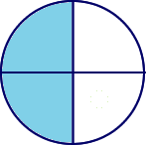
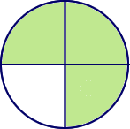
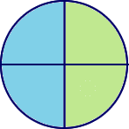
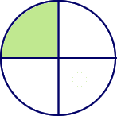
Adding and subtracting simple fractions
1
3
What is + ?
2
4
+
=
1
3
1
1
+
=
2
4
4
Notes:
This time the answer is more than 1.
If we add 2 of the quarters to ¹/₂ that makes 1 whole, plus the other quarter makes 1¹/_{4.}
We can show this with the following diagrams.
Click to reveal.

Slide 7
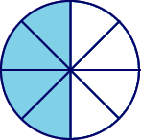
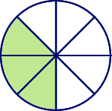
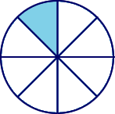
Adding and subtracting simple fractions
1
3
What is – ?
2
8
–
=
1
3
1
–
=
2
8
8
Notes:
Ask pupils how we could work this out mentally.
If we think of ¹/₂ as ⁴/₈, then the calculation is much easier.
Explain that the diagram shows ¹/₂ is equivalent to ⁴/₈.

Slide 8
Fractions with common denominators
Fractions are said to have a common denominator if they have the same denominator.
For example,
11
4
5
,
and
12
12
12
all have a common denominator of 12.
We can add them together:
11
4
5
11 + 4 + 5
20
1
8
1
2
+
+
=
=
=
=
12
12
12
12
12
12
3
Notes:
Remind pupils that since the denominators are the same we can write the sum over a single bar with 12 underneath. (Using a single bar will avoid the problem of adding denominators in error).
Give some examples of subtraction verbally.
What is ¹¹/₁₂ – ⁵/₁₂? (⁶/₁₂ which is equivalent to ¹/₂)
Remind pupils that improper fractions should be written as mixed numbers and fractions, where necessary, should be written in their lowest terms (cancelled down).

Slide 9
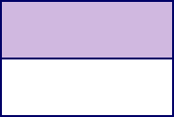



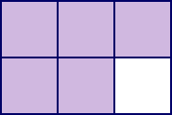
Fractions with different denominators
Fractions with different denominators are more difficult to add and subtract.
For example,
1
1
What is
+
?
2
3
We can show this sum using diagrams:
+
=
3
2
3 + 2
5
+
=
=
6
6
6
6
Notes:
Point out, with reference to the diagrams that we cannot add 1/2 + 1/3 directly. The answer is certainly not 2/5, as some pupils may think!
Ask pupils to suggest ways of adding these fractions.
We know that 1/2 is equivalent to 3/6 and 1/3 is equivalent to 2/6.
Click to divide the shapes into sixths.
6 is the lowest common multiple of 2 and 3.
Once we have written both fractions with a common denominator, we can add them together.

Slide 10





Using diagrams
5
2
What is
–
?
6
9
–
=
15
4
15 – 4
11
–
=
=
18
18
18
18
Notes:
Here are some more examples using diagrams.
Talk through the example.
Reveal the diagrams of ⁵/₆ and ²/₉.
What is the lowest common multiple of 6 and 9?
As a mental method for finding the lowest common multiple instruct pupils to take the larger of the two denominators, in this case 9, and go through multiples of 9 (in order) until they find a multiple of 9 which is also a multiple of 6.
9 is not a multiple of 6, but the next multiple of 9, 18, is.
Click to divide the diagrams into ¹/₁₈s.

Slide 11
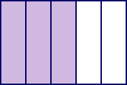
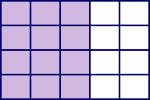
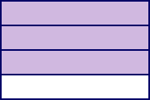
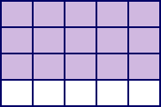
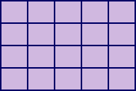
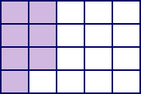
Using diagrams
3
3
What is
+
?
5
4
+
=
12
15
12 + 15
27
1
7
+
=
=
=
20
20
20
20
20
Notes:
Talk through the example.
Reveal the diagrams of 3/5 and 3/4.
What is the lowest common multiple of 5 and 4?
Again, take the larger of the two denominators, in this case 5, and go through multiples of 5 (in order) until we find a multiple of 5 which is also a multiple of 4.
10 is not a multiple of 4, nor is 15, but the next multiple of 5, 20, is.
Let’s divide these rectangles into ¹/₂₀s.
Click to reveal.

Slide 12
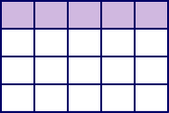
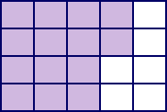
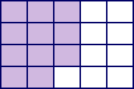

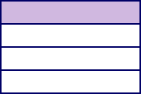
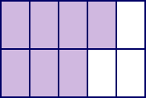
Using diagrams
1
1
7
What is
–
?
4
10
–
=
25
14
25 – 14
11
–
=
=
20
20
20
20
Notes:
Talk through the example as before.

Slide 13
Using a common denominator
1
3
1
5
What is
+
+
?
4
9
12
1) Write any mixed numbers as improper fractions.
1
3
=
7
4
4
2) Find the lowest common multiple of 4, 9 and 12.
The multiples of 12 are:
12,
24,
36 . . .
36 is the lowest common denominator.
Notes:
Let’s add these fractions without using a diagram.
We must follow these steps.
Revise method for changing mixed numbers to improper fractions. (This step could be left out if we add whole number parts together separately from fractional parts).
2) We need to write the fractions over a common denominator. The lowest common denominator is equal to the lowest common multiple of the denominators.
Tell pupils that one way to do this is to go through the multiples of the highest denominator, in this case 12, until we find a multiple of 12 which is divisible by the other denominators, in this case 4 and 9. Going through multiples of 12.
12 is divisible by 4 but not by 9, 24 is divisible by 4 but not by 9, 36 is divisible by both 4 and 9. Therefore, 36 is the lowest common multiple.

Slide 14
Using a common denominator
1
3
1
5
What is
+
+
?
4
9
12
3) Write each fraction over the lowest common denominator.
×9
×4
×3
7
63
1
4
5
15
=
=
=
4
36
9
36
12
36
×9
×4
×3
4) Add the fractions together.
63
4
15
63 + 4 + 15
82
2
10
2
5
+
+
=
=
=
=
36
36
36
36
36
36
18
Notes:
3) Review the method for finding equivalent fractions.
4) Remind pupils that the answer should be written as a mixed number and cancelled down if possible.

Slide 15



Using a calculator
It is also possible to add and subtract fractions using the
a
key on a calculator.
b
c
4
4
a
8
For example, to enter
we can key in
b
8
c
The calculator displays this as:
Pressing the
=
key converts this to:
Notes:
Allow pupils a few moments to locate the fraction key on their calculators. Demonstrate how this key on the calculator can be used to simplify fractions (both to cancel fractions and to write improper fractions as mixed numbers).

Slide 16

Using a calculator
To calculate:
2
4
+
3
5
using a calculator, we key in:
2
a
3
+
4
a
5
=
b
b
c
c
The calculator will display the answer as:
1
7
We write this as .
15
Notes:
Point out that although it is easy to use a calculator to add and subtract fractions they must be able to do it, demonstrating the full method, without using a calculator. Pupils can then use the calculator to check their answers.

